Slide 1
Fundamentals of Image Formation
Lecture 2
Jitendra Malik

Slide 2


A camera creates an image …
The image I(x,y) measures how much light is captured at pixel (x,y)
We want to know
Where does a point (X,Y,Z) in the world get imaged?
What is the brightness at the resulting point (x,y)?

Slide 3
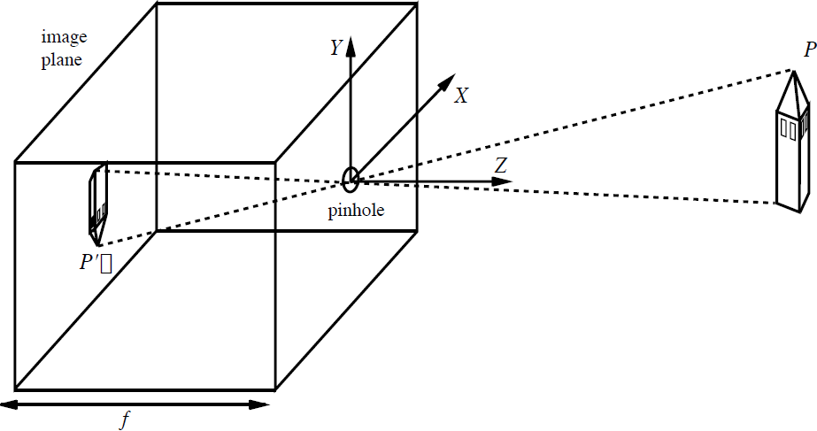



The Pinhole Camera
y
x

Slide 4

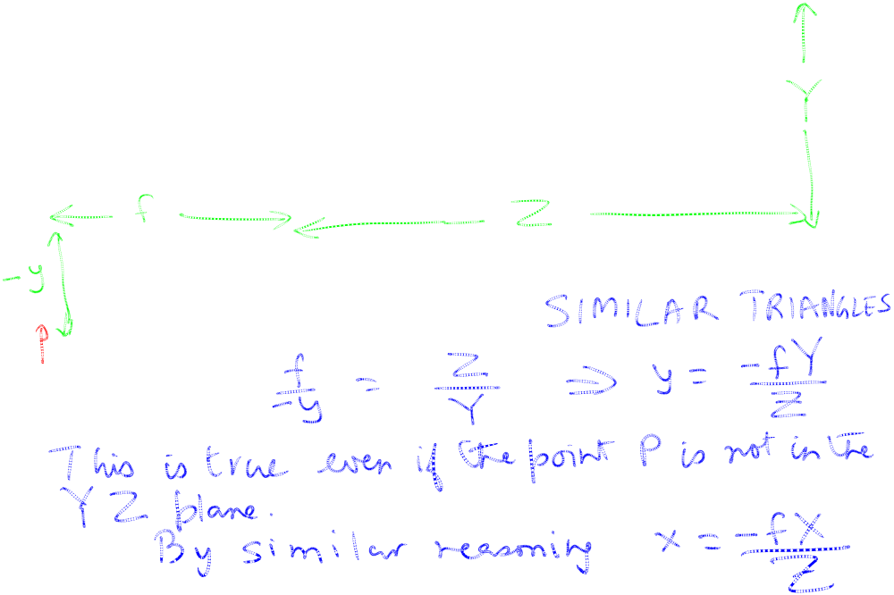



Let us prove this …
(This diagram is for the special case of a point P in the Y-Z plane)

Slide 5



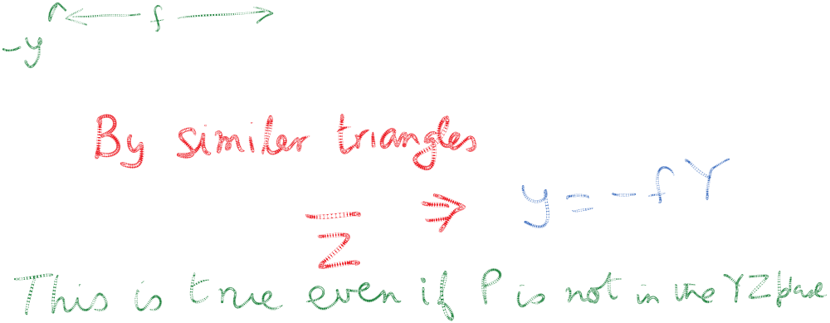



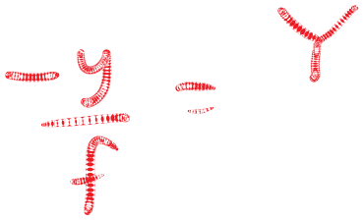

Let us prove this …
(This diagram is for the special case of a point P in the Y-Z plane)

Slide 6
The Pinhole Camera
y
x

Slide 7
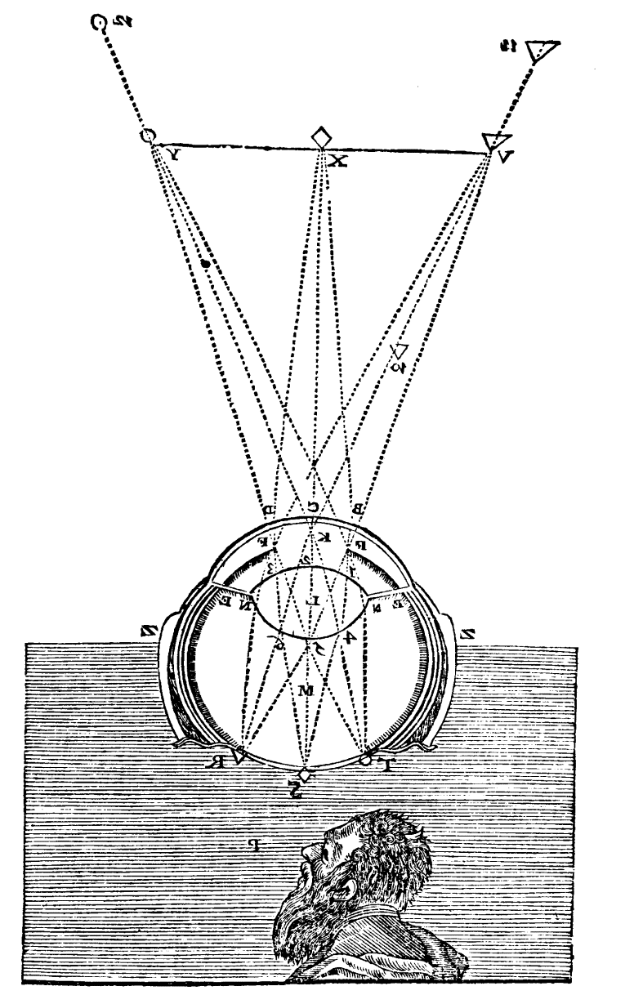

The image is inverted
This was pointed out by Kepler in 1604
But this is no big deal. The brain can interpret it the right way. And for a camera, software can simply flip the image top-down and right-left. After this trick, we get
From Descartes(1637), La Dioptrique

Slide 8
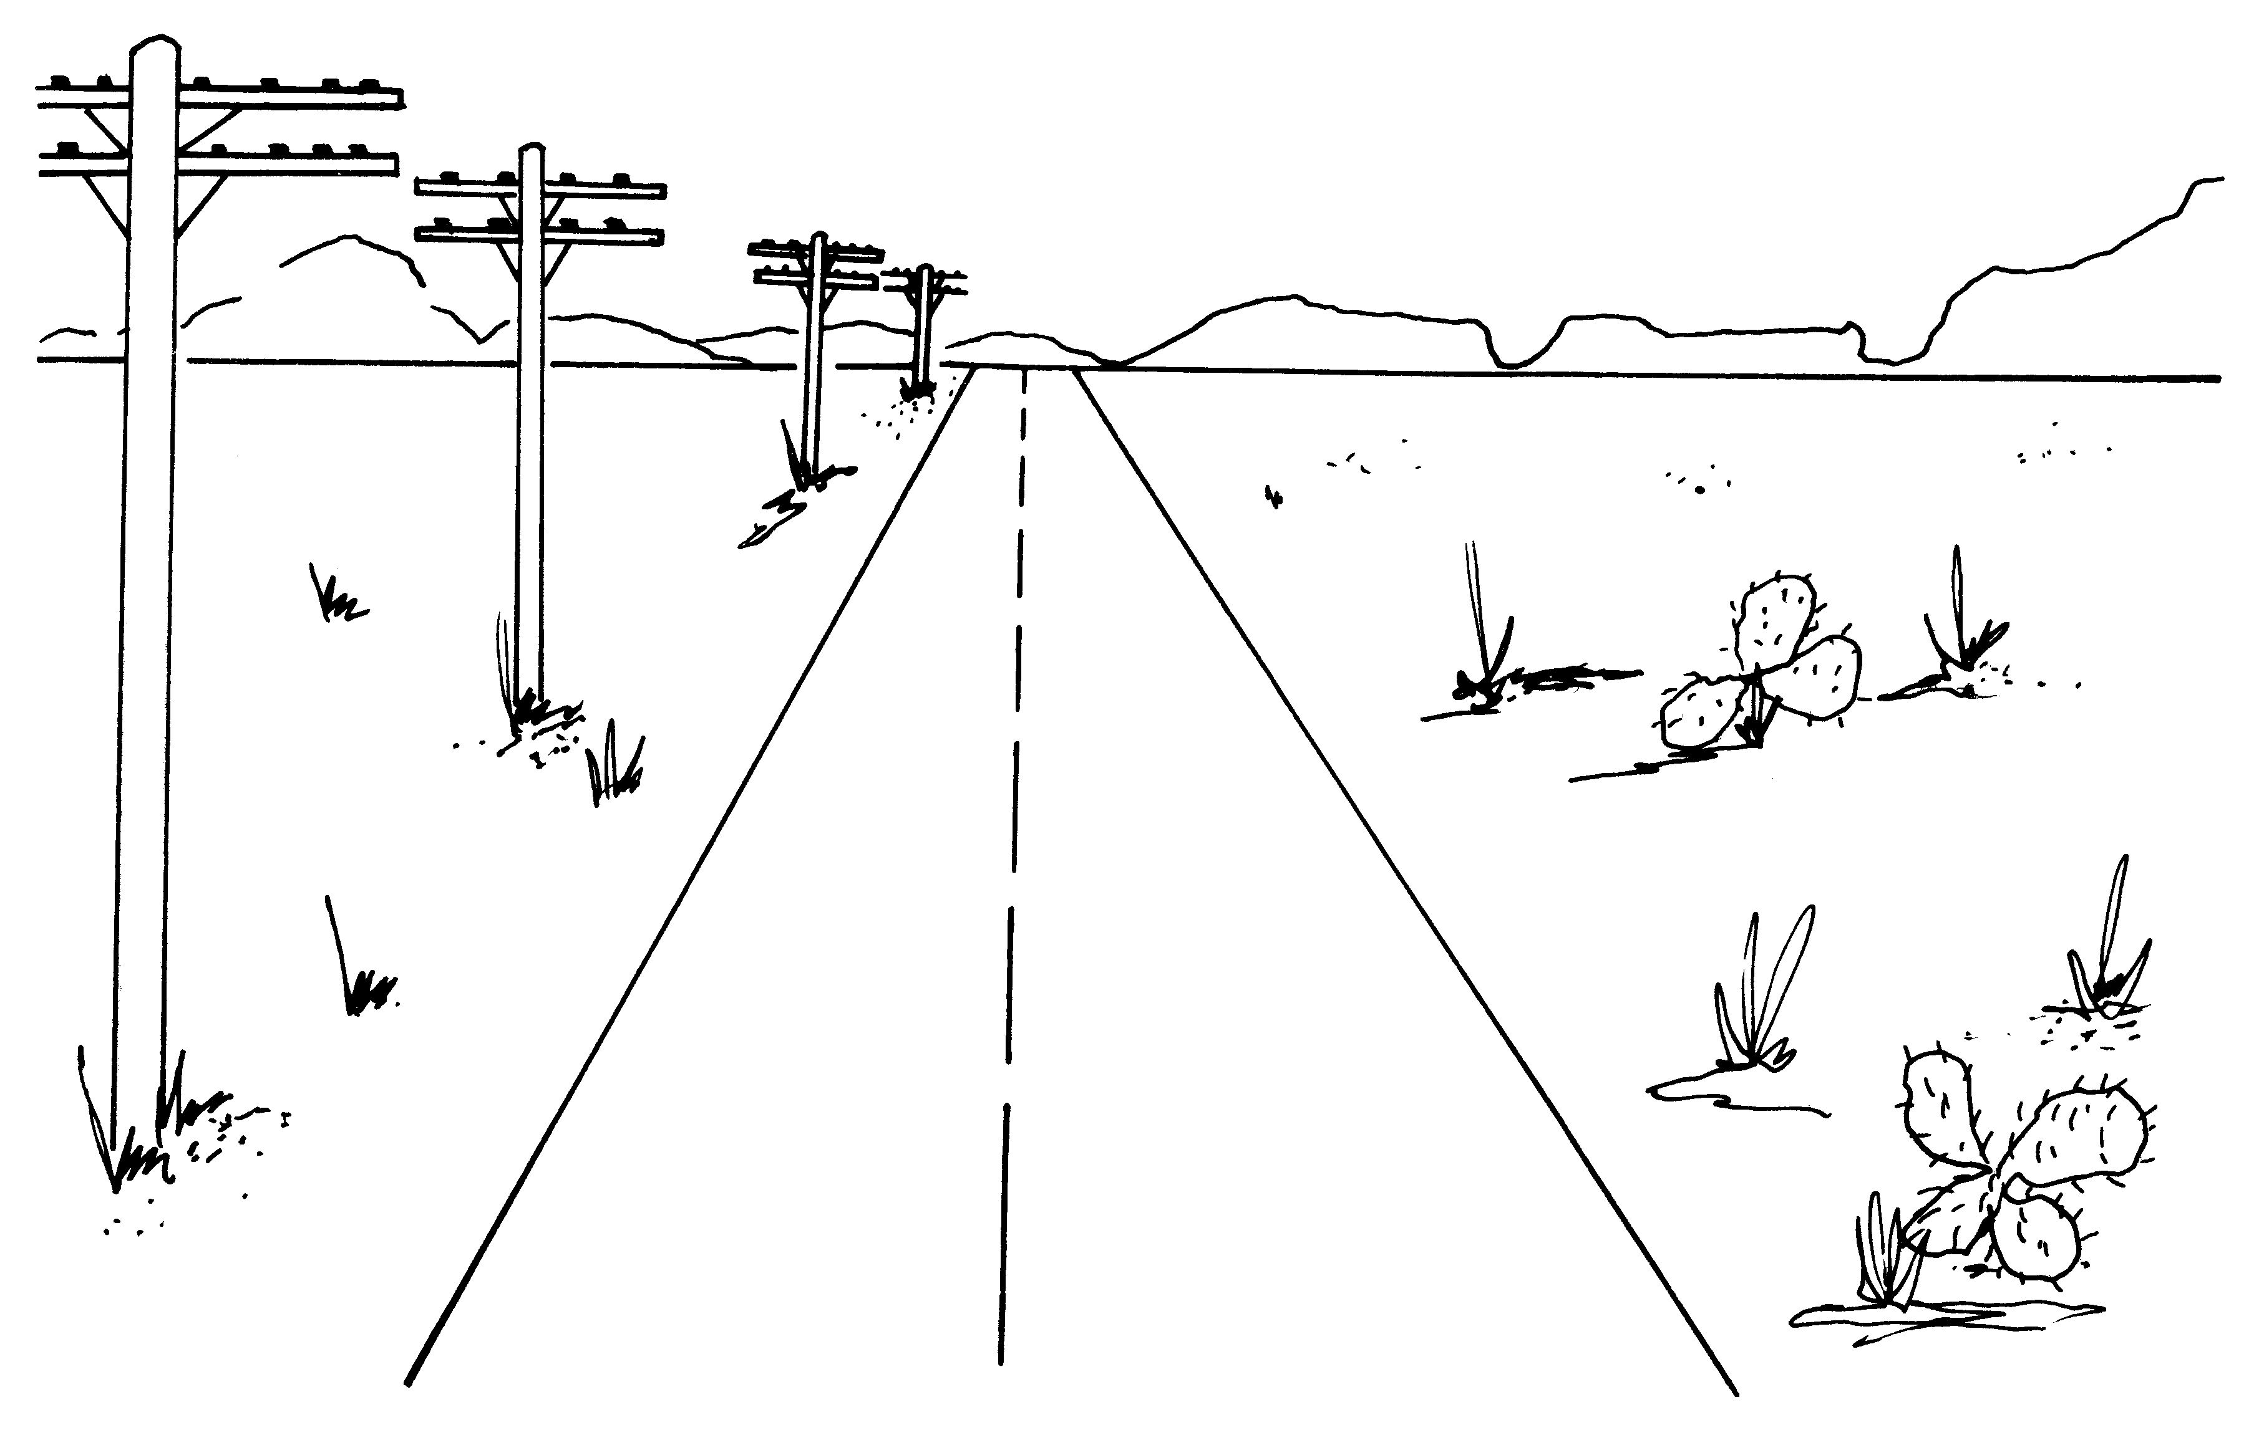
Some perspective phenomena…

Slide 9





Parallel lines converge to a vanishing point

Slide 10
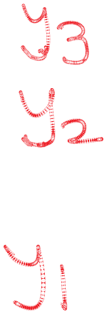
Nearer objects are lower in the image

Slide 11
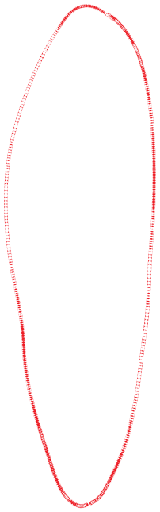

Nearer objects look bigger

Slide 12
Parallel lines converge to a vanishing point

Slide 13
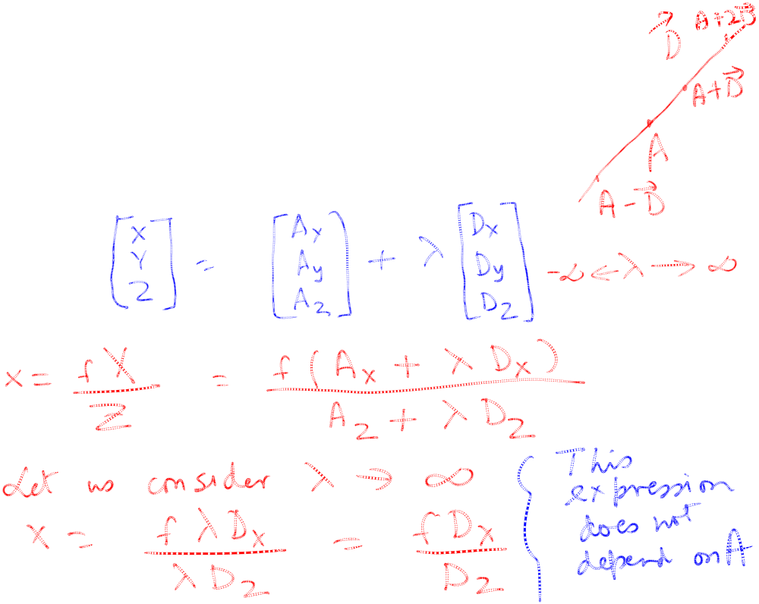
Proof
Let there be a point A and a direction vector D in three dimensional space.

Slide 14
